Slide 1

Optimizing Chatbot User Satisfaction through Bayesian Optimization -An Experimental Optimization Project Instructor: Prof. David Sweet Presented By: - Anuj Kumar Shah - Goutham - Sai - Jitendra - Sameer - Wei LO - Prathana - Vedant

Slide 2
Problem Statement
To maximize chatbot user satisfaction by identifying the optimal configuration of three key parameters (x1,x2,x3) within a constrained environment.
Considering parameters
x1​: Engagement Calibration
x2: Responsiveness Factor
x3: Contextual Balance
Y: User Satisfaction Score

Slide 3

Strategy
Data Collection:
Measurements collected daily from a server API.
Each API call returns a satisfaction score for given parameters.
Data Analysis:
Process raw data to extract useful insights and clean anomalies.
Perform statistical analysis to identify trends and correlations.
Optimization:
Use Bayesian Optimization to find the best parameter combination iteratively.
Validation:
Perform A/B testing to compare baseline (A) with optimized parameters (B).
Assess both statistical significance (p-value) and practical significance (business impact).

Slide 4
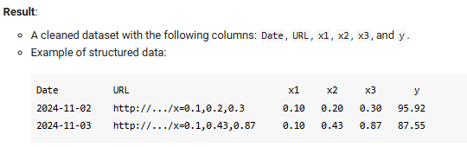
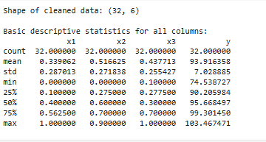
Dataset Overview
Data Source:
Data collected from server API calls with sid=1979.
Structure:
Each record contains the date, API URL, parameters (x1, x2, x3), and user satisfaction score (y).
Initial Statistics:
Total measurements: 32 valid samples after cleaning.
Average Satisfaction Score: 93.92
Standard Deviation: 7.03
Data Preprocessing:
Removed NaN values from records.
Extracted x values and satisfaction scores from JSON responses.

Slide 5
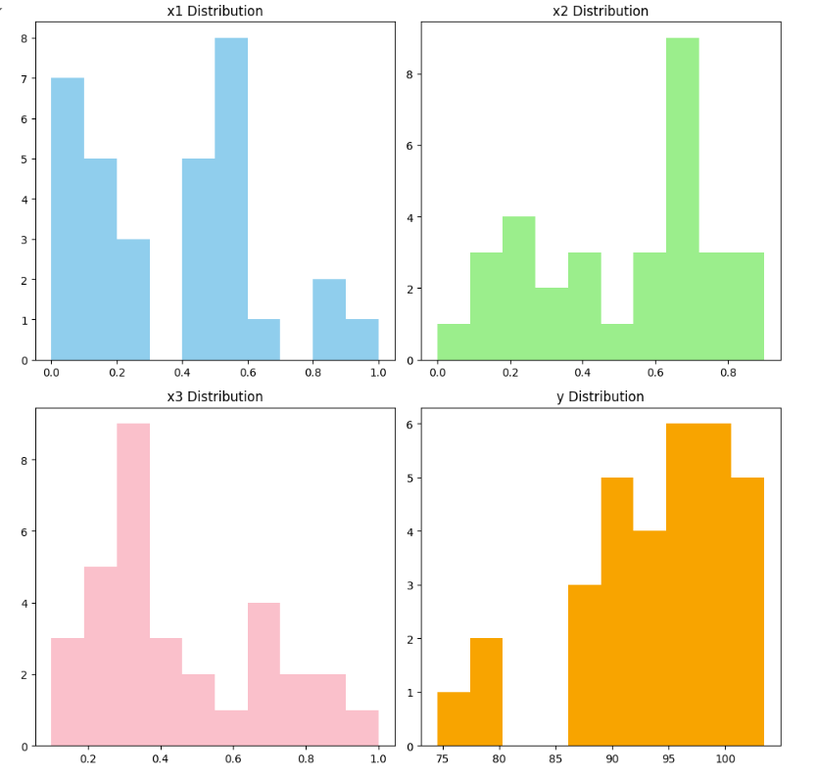
Exploratory Data Analysis
Distribution Analysis:
Histograms of x1, x2, x3, and y to understand parameter spread and satisfaction distribution.
Insights
x1: Shows moderate spread across the range [0, 1].
x2: Skewed distribution with higher frequency near 0.6.
x3: Concentration near lower and mid-range values.
y: Majority of satisfaction scores are clustered around the mean (93.92) with some variability.
The response variable (y) shows a relatively normal distribution centered around the mean.

Slide 6
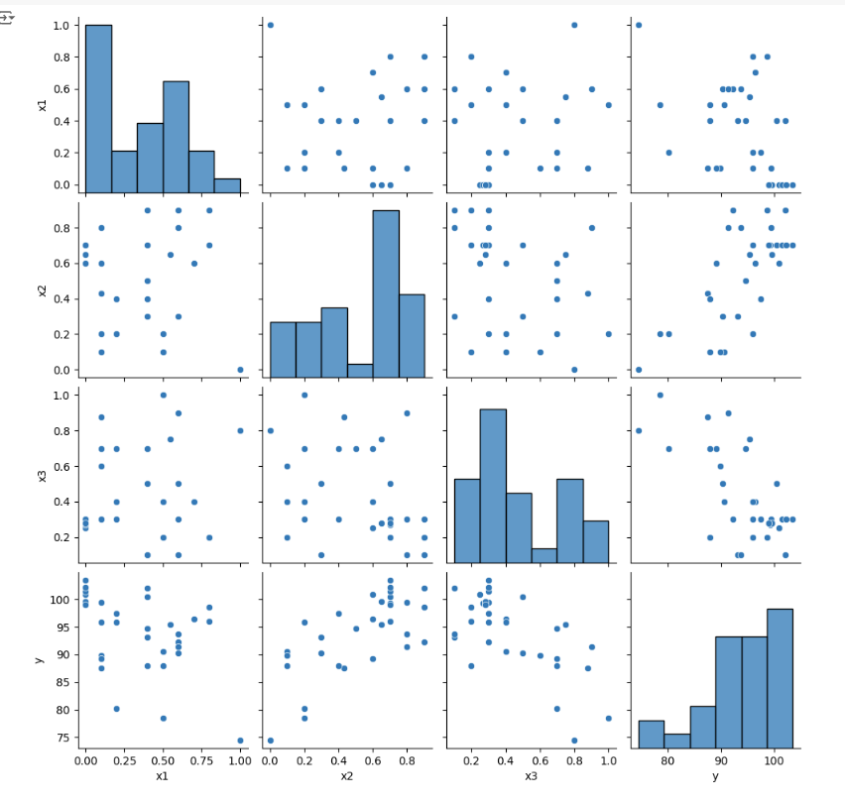
Exploratory Data Analysis
Pairwise Relationships:
- Scatter matrix showing correlations among x1, x2, x3, and y.
Observations:
- Scatter plots reveal potential patterns between variables and y.
Histograms along the diagonal display individual variable distributions.
Insights :
x2 shows a positive correlation with satisfaction.
x3 has a negative correlation with satisfaction.
No significant linear trends for x1.

Slide 7
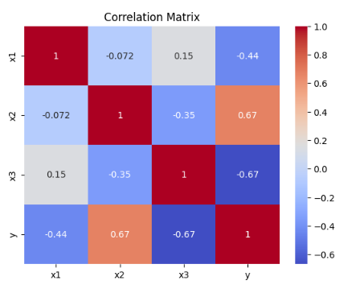
Exploratory Data Analysis
Correlation Matrix:
x2 shows a positive correlation with y (0.67), indicating it has a strong impact on satisfaction.
x3 is negatively correlated with y (-0.67), suggesting an inverse relationship.
x1 has a weaker negative correlation with y (-0.44), implying a moderate impact.

Slide 8
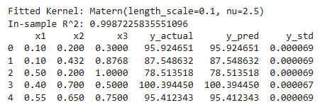
Gaussian Process Regression (GPR)
Why GPR?:
Efficient for modeling noisy data and generating uncertainty estimates.
Implementation:
Kernel: Matern with length scale = 0.1 and ν=2.5.
Model trained on cleaned data (x1, x2, x3 → y).
Results:
In-sample R²: 0.999
Predicted vs Actual satisfaction scores show a nearly perfect fit.
Insights
This step confirms that Gaussian Process Regression (GPR) is a reliable model for optimizing chatbot parameters.
With such accurate predictions, we can confidently use this model to explore the parameter space and find the optimal configuration to maximize satisfaction scores.

Slide 9
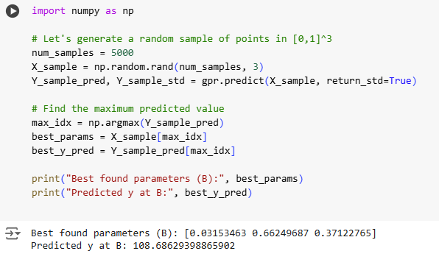
Best Parameter Identification
Best Found Parameters and Predicted Value
Best Found Parameters (B):
x1: 0.0315
x2: 0.6625
x3: 0.3712
These parameters represent the optimal configuration for maximizing user satisfaction as determined by the Gaussian Process Regression (GPR) model.
Predicted Satisfaction Score at B:
Predicted y: 108.69
This is the maximum predicted satisfaction score based on the sampled parameter space.
Significance for the Project:
These results identify the optimal parameter configuration for the chatbot system.
Using Bayesian optimization with GPR, we ensure the model efficiently explores the parameter space, leading to the best possible user satisfaction score.
We will test this optimal configuration in the A/B test to validate its effectiveness against the baseline configuration.
We generate 5000 random samples in the parameter space [0,1]^3 and use the trained Gaussian Process Regression (GPR) model to predict satisfaction scores (y)

Slide 10
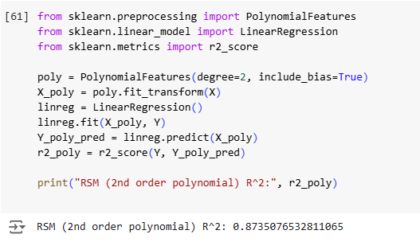
Response Surface Model (RSM)
Second-order polynomial regression is used to capture interactions between parameters.
Model Fit:
The second-order polynomial regression achieved an R² score of 0.8735.
Significance:
The R² score indicates that approximately 87.35% of the variance in the target variable (y) is explained by the polynomial regression model.
Compared to the Gaussian Process Regression (R² ≈ 0.9987), the polynomial model performs well but does not capture the underlying data as effectively.
Conclusion:
While polynomial regression provides a good approximation, it is less flexible than Gaussian Process Regression for capturing complex relationships in the data.

Slide 11
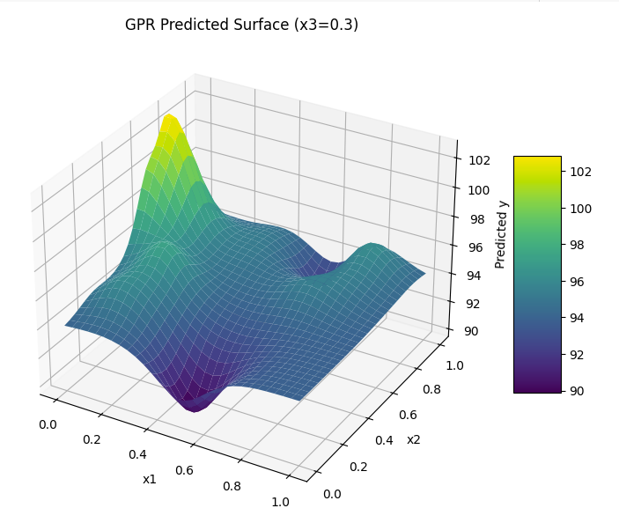
3D Visualization of Gaussian Process Predictions
Interpretation
3D Surface Plot:
The plot displays the predicted response (y) for various combinations of x1 and x2, while keeping x3 fixed at 0.3.
The color gradient on the surface indicates the magnitude of the predicted values, with yellow representing higher values and purple representing lower values.
Key Insights:
The surface provides a visual representation of how changes in x1 and x2 influence the predicted response.
Peaks or valleys in the plot highlight optimal regions or areas where the response is maximized or minimized.

Slide 12
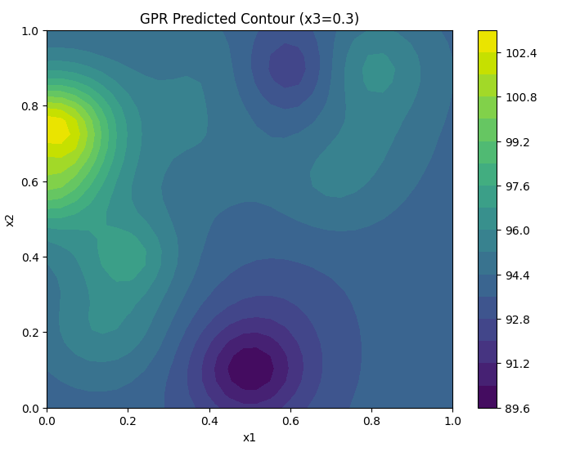
2D Contour Visualization of Gaussian Process Predictions
Interpretation
2D Contour Plot:
The plot provides a detailed view of how x1 and x2 affect the predicted response (y), with x3 held constant at 0.3.
Higher predicted values (y) are represented in brighter yellow regions, while lower values are shown in darker purple areas.
Key Insights:
The contours highlight specific regions where the response (y) reaches its maximum or minimum.
Sharp gradients between contours indicate areas of rapid change in the response.
Conclusion:
This visualization effectively identifies optimal combinations of x1 and x2 for maximizing or minimizing the response, aiding in parameter optimization.

Slide 13
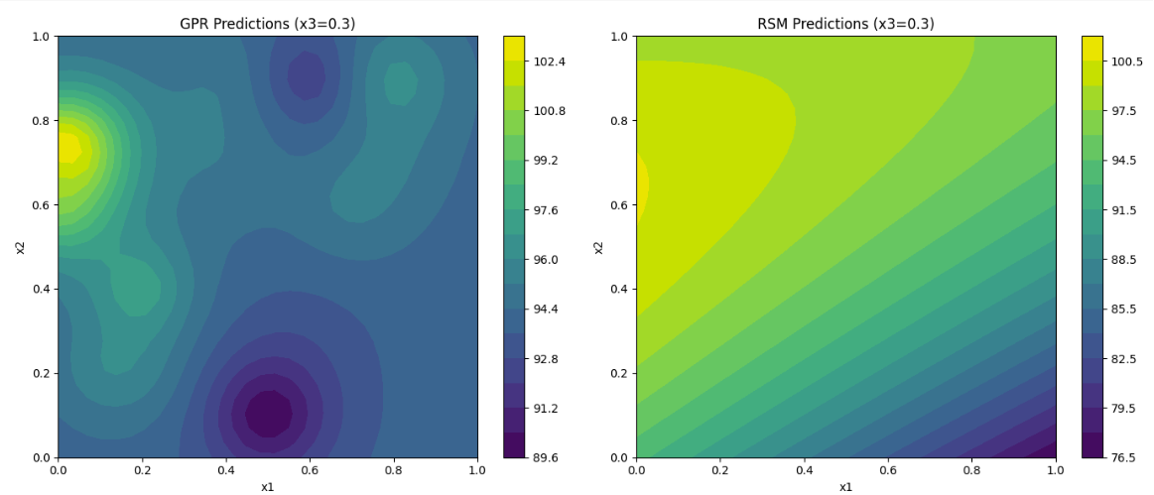
Comparison of GPR and RSM Contour Predictions
Interpretation
GPR Predictions:
The contour plot shows highly non-linear relationships between x1 and x2.
Highlights specific regions with maximum predicted responses (bright yellow).
RSM Predictions:
The contours are smoother and lack the granularity seen in the GPR predictions.
Indicates the limitations of polynomial models in capturing complex patterns.
Key Insights:
The GPR model is better suited for identifying precise regions with optimal responses, whereas RSM provides an approximate but less detailed view.
This comparison emphasizes the value of advanced methods like GPR in experimental optimization.

Slide 14
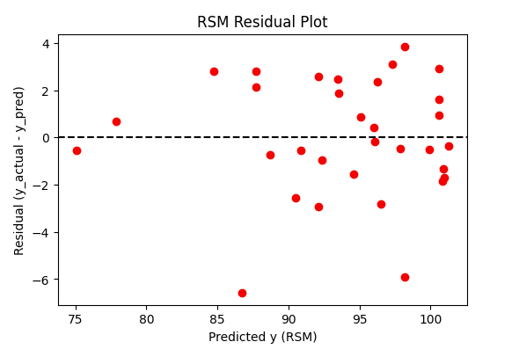
Residual Analysis for RSM Predictions
Interpretation
Residual Distribution:
The residuals are spread both above and below the zero line, indicating prediction errors.
No visible pattern in the residuals, which suggests the polynomial model has captured most of the relationships in the data.
Key Observations:
The spread of residuals increases slightly at higher predicted values.
Some residuals are relatively large, highlighting areas where the RSM model underperforms.
Conclusion:
While the RSM model provides reasonable predictions, the residual plot indicates that a more advanced model (e.g., GPR) might yield better accuracy and capture non-linear relationships more effectively.

Slide 15
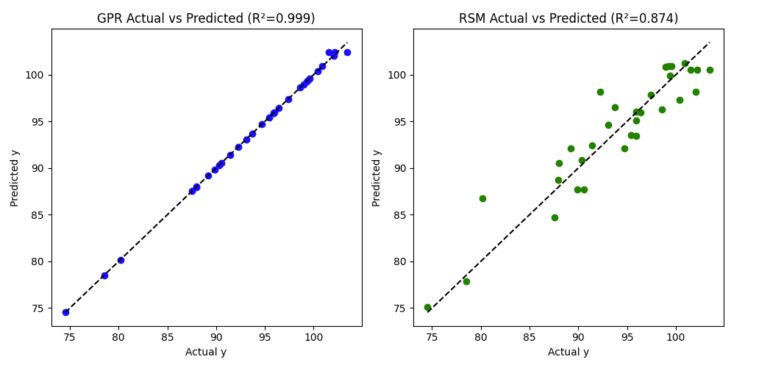
Model Evaluation: GPR vs. RSM
Gaussian Process Regression (GPR):
R² = 0.999: Near-perfect alignment between actual and predicted values.
Points are tightly clustered along the dashed line, indicating exceptional accuracy.
Response Surface Methodology (RSM):
R² = 0.874: Good overall fit but less accurate compared to GPR.
Points show more scatter around the dashed line, reflecting higher prediction errors.
Comparison:
GPR significantly outperforms RSM, providing more precise predictions with minimal residuals.
This reinforces the suitability of GPR for capturing complex, non-linear relationships in the data.
Conclusion:
While RSM is effective for simpler models, GPR offers superior performance in this context, making it the preferred approach for optimizing user satisfaction.

Slide 16
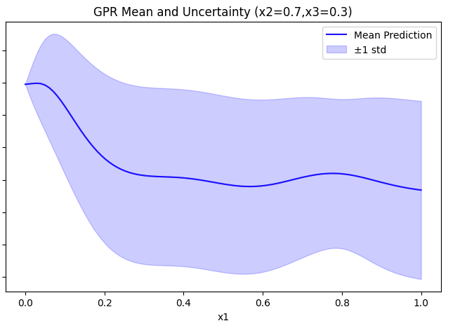
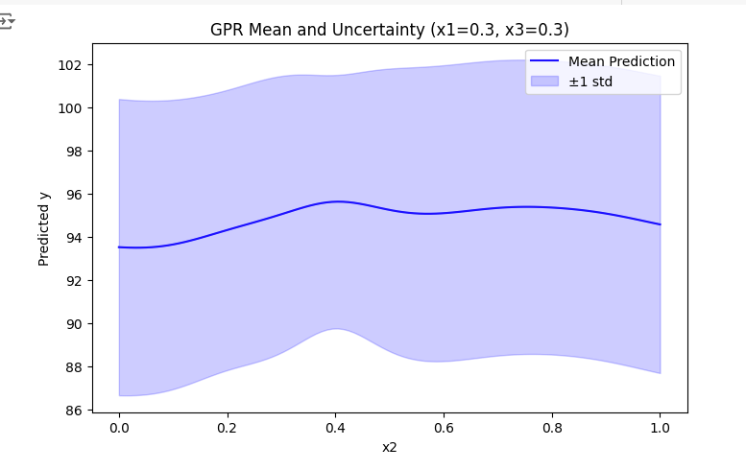
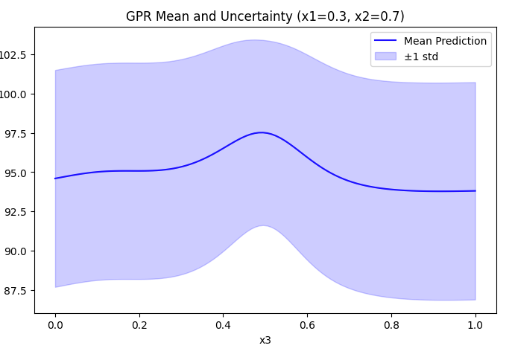
Mean Predictions and Uncertainty Analysis
Insights from Visualization
X1 Variations (Fixing X2=0.7, X3=0.3): Shows the dependency and uncertainty for X1.
X2 Variations (Fixing X1=0.3, X3=0.3): Displays similar insights for X2, highlighting regions of high confidence in predictions.
X3 Variations (Fixing X1=0.3, X2=0.7): Illustrates the impact of X3 on the satisfaction metric.
These insights allow for a better understanding of parameter influence and optimal decision-making.

Slide 17
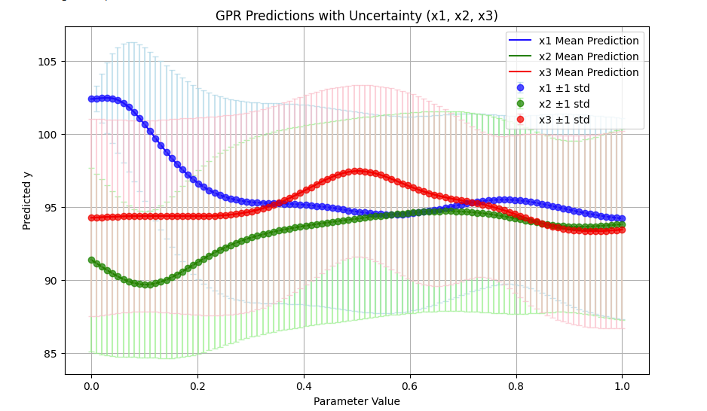
GPR Predictions with Uncertainity
Scatter Plot with Uncertainty:
The red dots represent the predicted values (y).
The gray error bars indicate ±1 standard deviation of uncertainty around each prediction.
The prediction confidence is higher where the error bars are smaller.
Uncertainty Analysis for Parameters:
The combined visualization shows how the uncertainty varies for each parameter (x1, x2, x3) when the others are fixed.
Larger standard deviations highlight regions where predictions are less reliable.
These plots reinforce the importance of exploring high-confidence parameter regions during optimization.

Slide 18
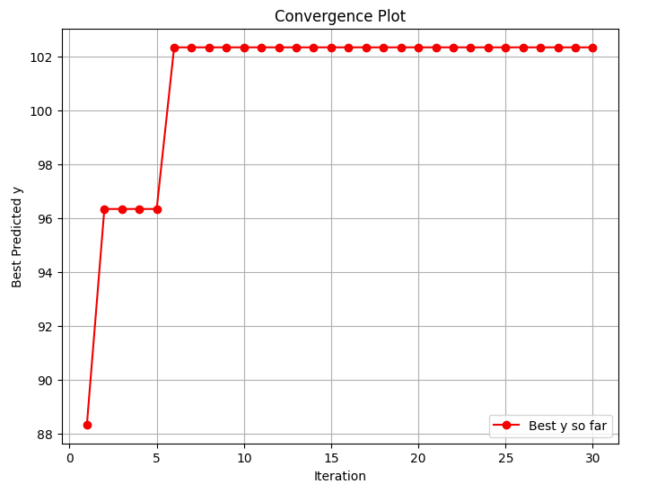
Bayesian Optimization Convergence Plot
The convergence plot shows how the optimization algorithm explores the parameter space and gradually converges to the best parameters, achieving a predicted y of approximately 102.
The rapid improvement in the first few iterations, followed by stabilization, indicates effective parameter tuning with Bayesian optimization.

Slide 19
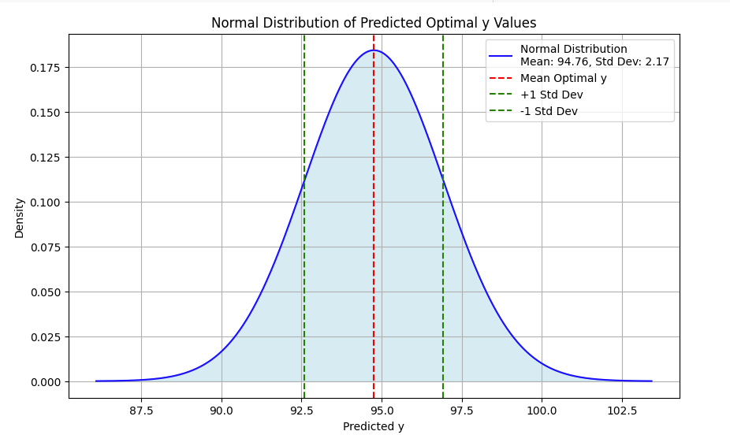
Normal Distribution of Predicted Optimal y Values
Observations:
Mean: The optimal predicted y value is centered at 94.76.
Standard Deviation: The variability around the mean is ±2.17, indicating the range of probable outcomes.
Significance: The shaded region within ±1 standard deviation encompasses most predicted values, aligning with the expected distribution for GPR predictions.
Insight This distribution aids in understanding the certainty and variability of the optimized parameter predictions, which is crucial for interpreting the model's reliability and robustness.

Slide 20
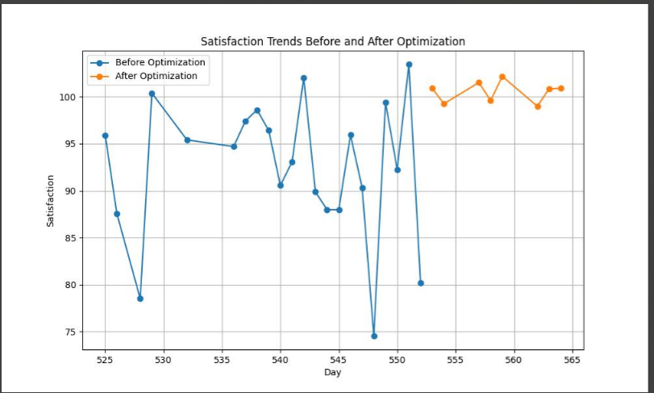
Comparison between Random vs Optimized X values
Mean Satisfaction before Optimization: 92.39
Mean Satisfaction after Optimization: 100.52

Slide 21
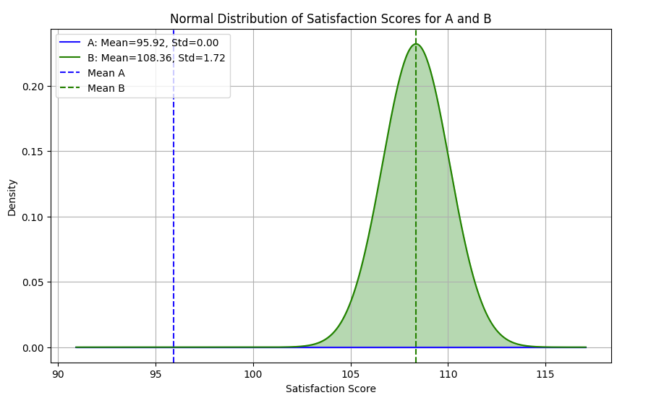
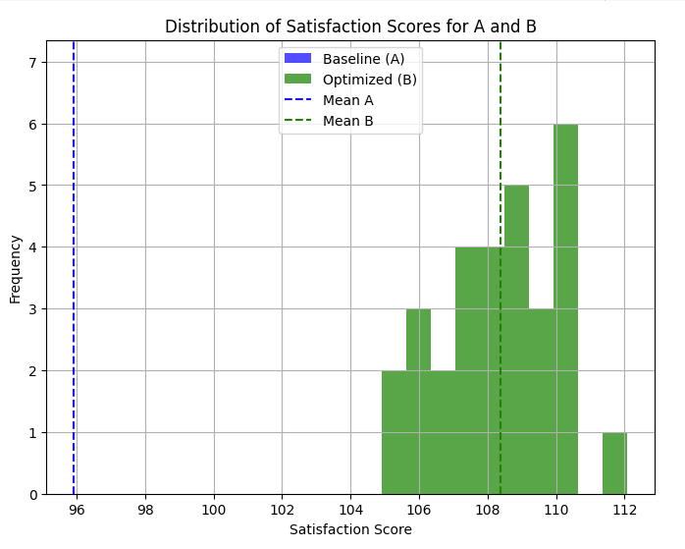

A/B Test
Purpose: To validate whether the optimized parameters (B) are statistically and practically better than baseline (A).
Results:
T-Test:
T-statistic: -38.94
P-value: <0.001
Conclusion: Statistically significant improvement.
Confidence Intervals:
A: [95.92, 95.92]
B: [107.71, 109.01]
No overlap, confirming significant improvement.
Practical Significance:
Threshold: 100
Predicted satisfaction for B (108.69) exceeds the practical significance threshold.

Slide 22
Key Insights
Limitations and Future Work
Optimization:
Significant improvement achieved by Bayesian Optimization.
Comparison:
GPR outperforms RSM in predictive accuracy and residuals.
Practical Takeaway:
Optimization led to statistically and practically significant improvements in satisfaction.
Limitations:
Small sample size (32 data points).
Limited exploration of higher-order interactions.
Future Work:
Increase dataset size through more measurements.
Experiment with alternative kernels for GPR.
Implement real-world A/B testing to validate results further.

Slide 23
Conclusion
Bayesian Optimization effectively maximized chatbot satisfaction.
Optimized parameters resulted in significant improvements over baseline.
GPR proved to be a robust tool for prediction and uncertainty quantification.
This approach can be extended to optimize other complex systems.

Slide 24
THANK YOU

